Slide 1
CsI 224: Database Sessional
LAB-5

Slide 2
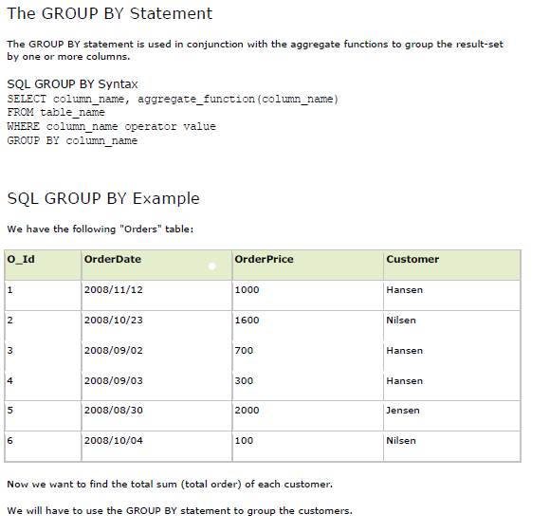

Slide 3
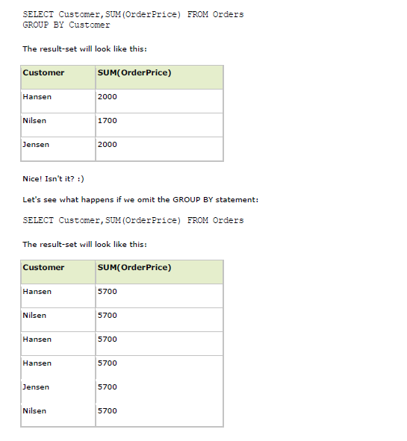

Slide 4
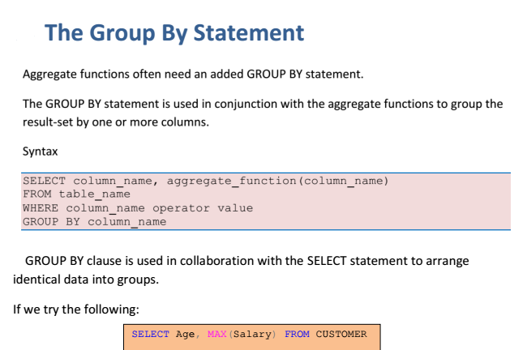

Slide 5
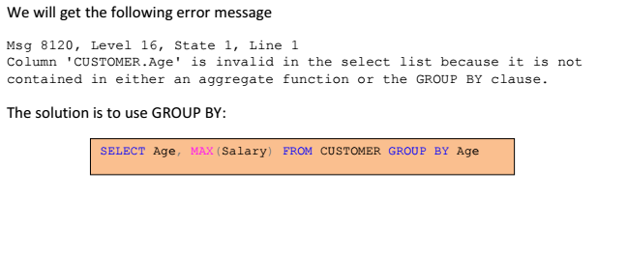

Slide 6
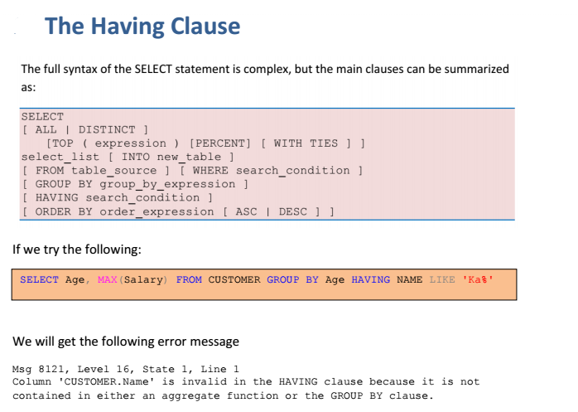

Slide 7
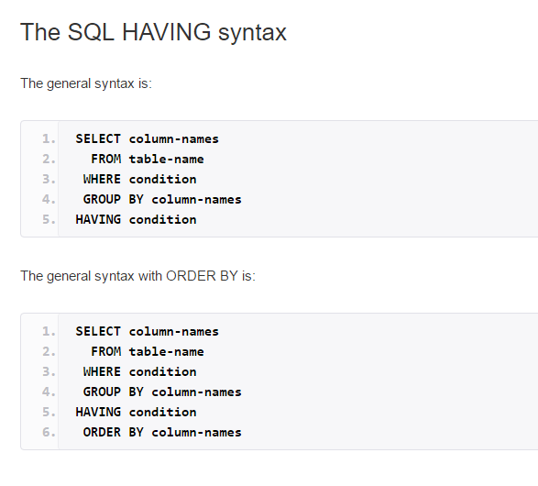

Slide 8
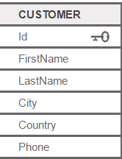

Slide 9


Slide 10
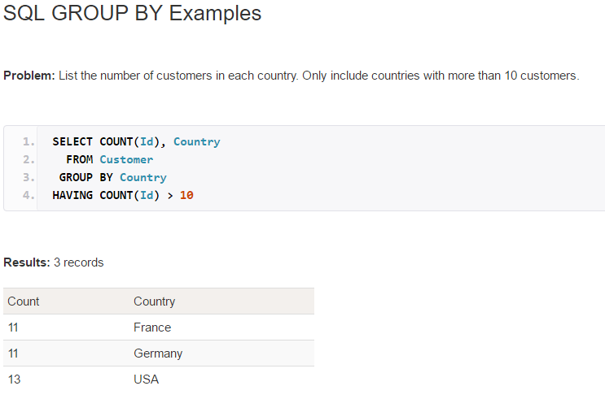

Slide 11
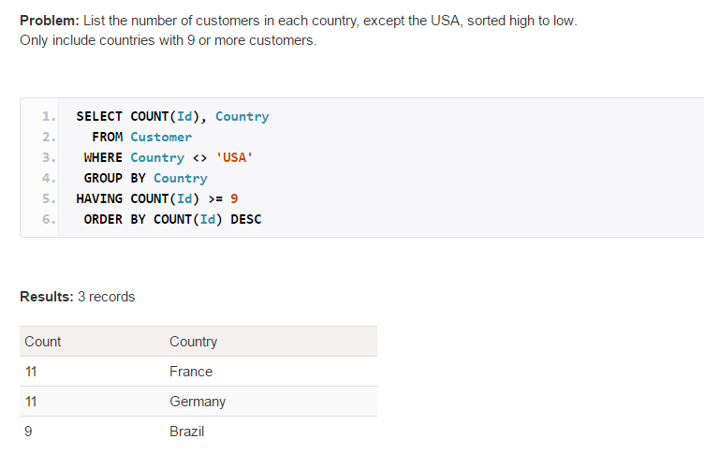

Slide 12
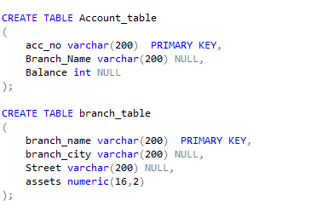
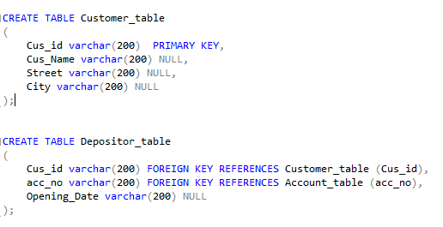

Slide 13
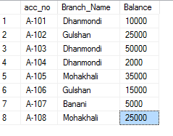
INSERT INTO Account_table VALUES ('A-101', 'Dhanmondi', 10000);

Slide 15
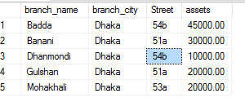
INSERT INTO branch_table
VALUES('Badda','Dhaka', '54b', 45000);

Slide 16
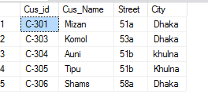
insert into customer_table values ('C-301','Mizan','51a','Dhaka');

Slide 17
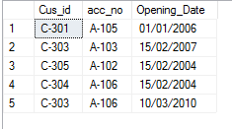
INSERT INTO Depositor_table VALUES('C-301', 'A-105', '01/01/2006');

Slide 18
1. Find the total sum of assets of street no. 51a.
2. Find the total balance of branches whose street is 51a.
3. Find the number of customers whose balance is greater than 10000.
4. Find the Customer id, name and city of the customer whose opening_date is '15/02/2004‘
5. Find the avg balance of each branch having total balance greater than 29000.
6. Find the customer_id, account_number,balance for all the customers who has an account at 'Dhanmondi' branch.
7. Find the name of the customer who has an account at 'Dhanmondi' branch.

